Slide 1
Put Your Input In, Take Your Output Out
TOPIC 2
Rigid Motions on a Plane
Bow Thai
Staring Back at Me
Turn Yourself Around
Put Your Input In, Take Your Output Out
1
2
3
4
5
OKEECHOBEE
Geometric Components of Rigid Motions

Slide 2

Learning Goals
Know precise definitions of line segment, angle, and distance along a line.
Translate lines to produce parallel lines.
KEY TERMS
function
collinear points
angle
ray
rotation angle

Slide 3
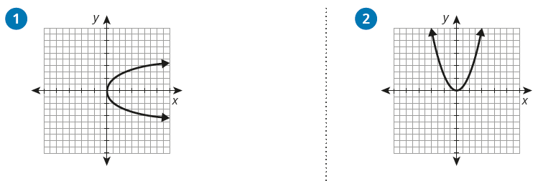
Review
> Use the vertical line test to determine whether each graph represents a function.
You know a lot about rigid motions, such as
translations, reflections, and rotations.
How do you use straight lines
and angles to represent rigid
motion transformations?

Slide 4

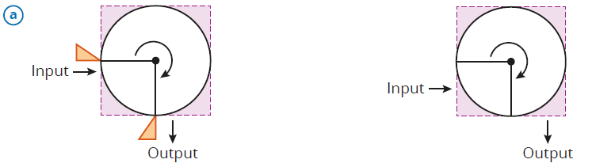
Getting Started
Transformation Machine
You have learned about function machines, which take a value as input and output another value. In this topic, you will learn to think about geometric rigid motions as functions. You can represent these functions with function machines—or transformation machines—as well.
Each transformation machine on the left shows a different rigid motion. For each transformation machine on the right, draw an input shape on patty paper. Then apply the transformation and draw the output shape.
THINK ABOUT...
A function takes
points, distances,
and angles as
inputs and outputs
a new set of points
after applying
a transformation.
Notes:
CHUNKING THE ACTIVITY:
Read and discuss the introduction
Group students to complete the activity
Share and summarize
QUESTIONS TO SUPPORT DISCOURSE:
Intro
What makes an algebraic relation a function?
If it is a rigid motion transformation machine, which operations can it perform?
What makes a transformation a rigid motion?
What is an example of a transformation that is not a rigid motion?
Question 1
Why is the output inside the transformation machine box?

Slide 5

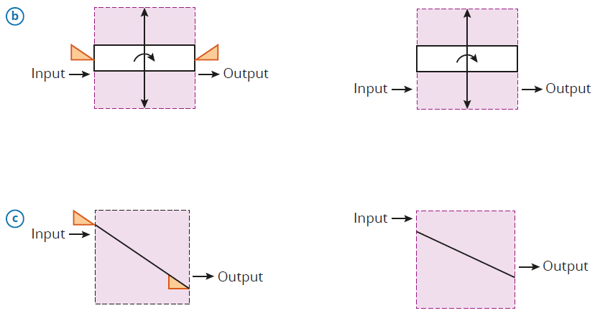
Getting Started

Slide 6
Getting Started
Identify the rigid motion represented by each transformation machine.
Describe each transformation function. Explain how each input shape is carried by geometric objects in the transformation machine to result in the output shape.
Notes:
QUESTIONS TO SUPPORT DISCOURSE:
Question 3
How many degrees is the clockwise rotation?
How could you describe this transformation with a counterclockwise rotation?
What is the orientation of the line of reflection?

Slide 7

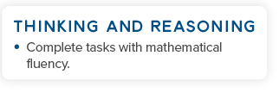
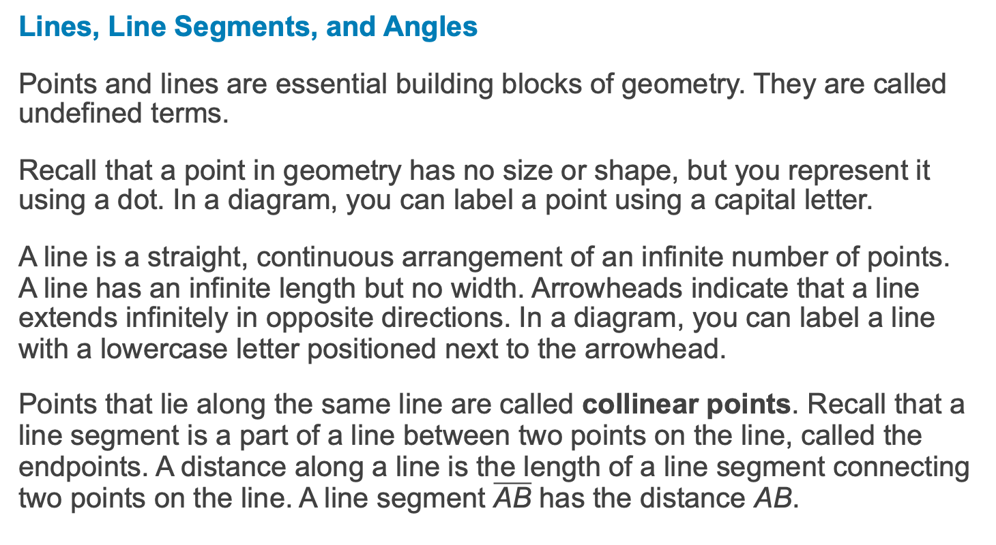
Activity 1
Lines, Line Segments, and Angles
Points and lines are essential building blocks of geometry. They are called undefined terms.
Recall that a point in geometry has no size or shape, but you represent it using a dot. In a diagram, you can label a point using a capital letter.
A line is a straight, continuous arrangement of an infinite number of points. A line has an infinite length but no width. Arrowheads indicate that a line extends infinitely in opposite directions. In a diagram, you can label a line with a lowercase letter positioned next to the arrowhead.
Points that lie along the same line are called collinear points. Recall that a line segment is a part of a line between two points on the line, called the endpoints. A distance along a line is the length of a line segment connecting two points on the line. A line segment $\overline{\text{AB}}$ has the distance AB.
REMEMBER...
A plane extends
infinitely in all
directions in two
dimensions and has
no thickness.
Notes:
CHUNKING THE ACTIVITY:
Read and discuss the introduction and definitions
Group students to complete 1 – 3
Check-in and share
Read and discuss the definitions
Complete 4 as a class
Share and summarize

Slide 8

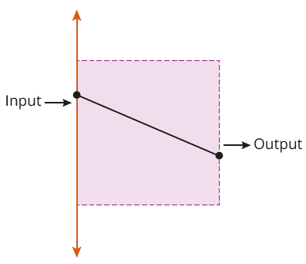
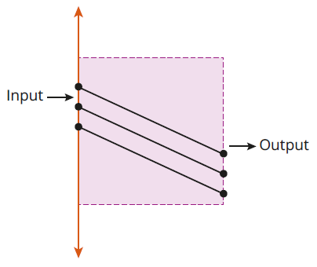
Activity 1
Consider the translation machine from the
Getting Started.
Suppose that the input to the machine is a line as shown. Describe the output of the translation machine.
Suppose that the translation machine is a set of parallel line segments as shown. How does this change the output of the machine when the input
is a line?
Notes:
QUESTIONS TO SUPPORT DISCOURSE:
Question 1
What effect does the translation have on the line?
What is the relationship between the input and output lines?
Label a point on the input line and described its position on the translated line.

Slide 9
Activity 1
Identify the line segments and distances used in the translation machines in the previous activity.
Are the line segments in the translation machine in Question 1, part (b), congruent? Use patty paper to justify your answer, and explain your reasoning.
REMEMBER...
Congruent line
segments are line
segments that have
the same length.
They represent
equal distances.
Notes:
QUESTIONS TO SUPPORT DISCOURSE:
Question 3
How could you use reasoning to tell the line segments are congruent?

Slide 10
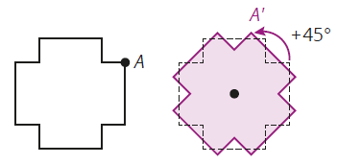
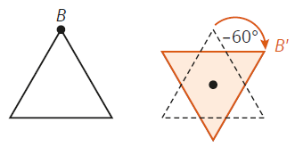
Activity 1
An angle is a set of points consisting of a vertex point and two rays extending from the vertex point. A ray is a portion of a line that begins with a single point and extends infinitely in one direction.
A rotation angle is a directed angle based on a circle.
A positive rotation angle turns counterclockwise.
A negative rotation angle turns clockwise.
Notes:
QUESTIONS TO SUPPORT DISCOURSE:
Diagrams
What is a negative rotation angle that would have the same results as the +45° rotation angle?
What is a positive rotation angle that would have the same results as the −60° rotation angle?

Slide 11
Activity 1
Identify the rotation angle used in the rotation machine in the Getting Started.
Notes:
QUESTIONS TO SUPPORT DISCOURSE:
Question 4
How did you know the rotation angle was negative?
Which benchmark angle(s) did you use to identify the 270° angle?

Slide 12

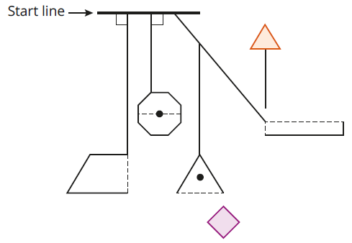
Talk the Talk
Shake It All About
In this activity, you will use a transformation machine that comprises line segments, figures with and without center points, and two target shapes. The transformation machine provides a path for each input shape—a triangle and a square—to move from the start line through the machine and map back onto itself.
Notes:
CHUNKING THE ACTIVITY:
Read and discuss the directions
Group students to complete the activity
Share and summarize

Slide 13

Talk the Talk
To use the transformation machine, you must first trace the target shape onto patty paper.
The transformation machine has these rules:
The elements in the transformation machine provide ways to move your input shape. You must keep your input shape connected to any of the lines or figures in the transformation machine by at least one vertex while translating, rotating, or reflecting.
Any dashed or solid line allows you to translate your input shape.
Any figure with a solid center point allows you to rotate your input shape around that center. The figure carries your input shape around the rotation.
Any figure with a dashed line allows you to reflect your input shape across that line. The figure carries your input shape across the reflection.
Notes:
QUESTIONS TO SUPPORT DISCOURSE:
Directions
How many locations are available on the start line?
What are the two meanings of a dashed line?
Explain what would happen if you started with a square at the first location on the start line.
Which transformation should you perform with the solid vertical line?
What options do you have once the figure reaches the trapezoid?

Slide 14
Talk the Talk
> Use the larger diagram of the transformation machine located on page 99.
Copy one of the target shapes onto patty paper. Place the input shape on the start line in an orientation of your choosing. Then determine a sequence of translations, reflections, and rotations that maps the input shape onto the corresponding target shape.
Describe the sequence of transformations you used to transform each
pre-image to each image. Label points on the transformation machine
so that you can precisely describe your transformations.
Consider the transformations performed on each pre-image to map it
onto the image. Are the images congruent to the pre-images?
Explain why or why not.
REMEMBER...
A pre-image is a
figure before a
transformation.
The image is the
figure after the
transformation.
Notes:
QUESTIONS TO SUPPORT DISCOURSE:
Question 2
Explain how an unsuccessful attempt guided you to modify your next try.
Is there another sequence of transformations that yields the same result?

Slide 15
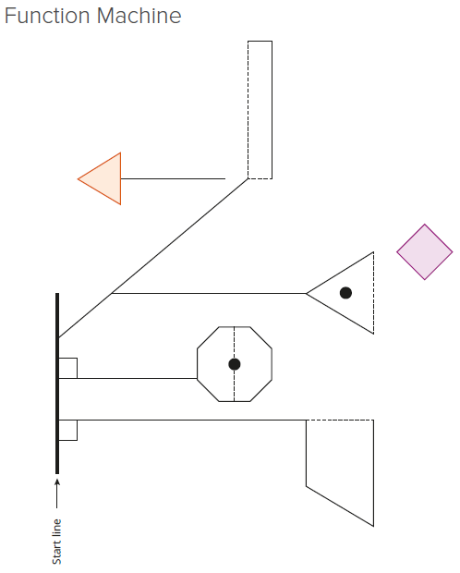
Talk the Talk

